Slide 1
Natural Language Processing for the Job Portal Enhancement
Group No- 5
Shah Abul Hasnat Chowdhury-17301143
Sanzid Al Nahian - 18101381
Ashik Iqbal- 19341033
Jawad Bin Jalil- 22141044

Slide 2
Content
Introduction+Abstract (Jawad)
NATURAL LANGUAGE PROCESSING (NLP) (Jawad)
PORTAL DAY ONLINE STRAY (Hasnat)
DATA COLLECTION(Hasnat)
COLLECTING DATA FOR KEYWORD PARSING (Ashik)
DATA PREPROCESSING (Ashik)
DATA PROCESSING (Sanzid)
Conclusion (Sanzid)

Slide 3

Introduction
This research is about job portal of job seekers by NATURAL LANGUAGE PROCESSING(NLP).

Slide 4

NATURAL LANGUAGE PROCESSING (NLP)
Development of human language applications and services.
Used for text analyses to allow computers to understand how people communicate.
This interaction of human-computers enables real-world applications

Slide 5
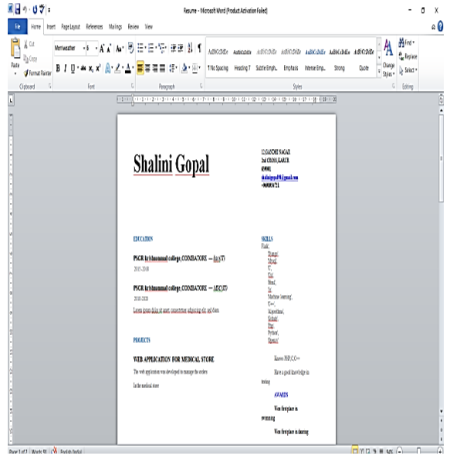
PORTAL DAY ONLINE STRAY
A forum for job seekers and recruiters
Choosing appropriate platform
THE VALUE PERCEPTION-Bridge between job seekers and recruiters
PRODUCT OF CONSISTENCY-Choosing right site for job
Professional Resume or CV for desired job

Slide 6
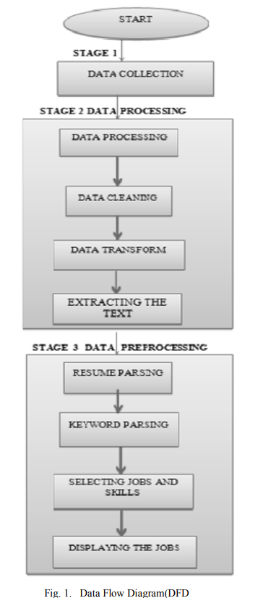
DATA COLLECTION
The right choice for data collection
Customization of a resume
Displaying the resume
Keyword and choosing the job
Creates a good overview

Slide 7
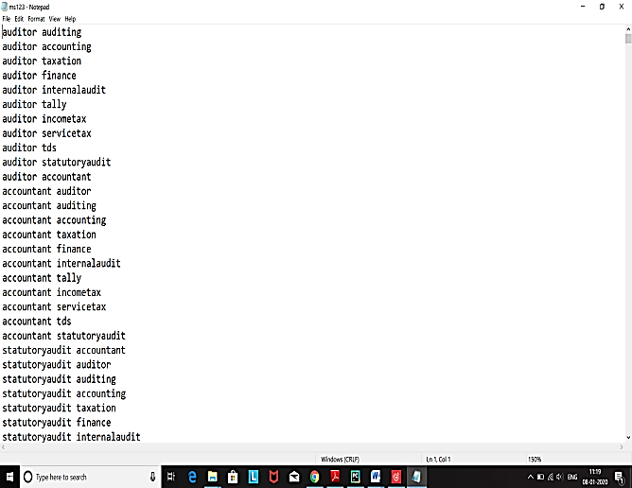
COLLECTING DATA FOR KEYWORD PARSING
Optimize the keywords for the application is not as easy as loading the form with industry-specific knowledge and jargon.
Modifying the terms to suit the job requirement in a list.
Keyword Parsing

Slide 8
DATA PREPROCESSING
Pre-processing of data is a technique used to turn the raw data into a clean collection of data.
Extracting Text From Doc And Docx.
The most significant difficulty is to interpret and translate the curriculum vitae into plain text.
Two Python modules are required to do this: pdfminer and doc2text.
Extracting Name
The best solution is to use regular expressions when extracting names from curricula
SpaCy is a natural language processing platform with industrial strength used for document and language analysis
SpaCy has a pre-trained interface for recognition, sorting and description of individuals
Extracting Phone Numbers and mail id’s
It uses regular expressions to extract telephone numbers and emails
Pandas offer an easy way of creating, manipulating and displaying data

Slide 9
DATA PROCESSING
A keyword-based CV parser uses the words, phrases, and simple patterns to identify and find understandable heuristic algorithms around these words in the text of the CV / Resume.
Keyword extraction consists of extracting in a document the most relevant words and phrases. It contributes to summarize the contents of a text and to recognize the main issues under discussion
Fast Text is a Facebook AI Research Laboratory library for learning word embedding and text classification. This model suggests a learning algorithm for terms with unattained or supervised vector representations.

Slide 10
Conclusion
The goal of the Natural Language Processing Project Career Creation Platform is to track jobs across multiple sectors to identify top applicants and top jobs.
The main goal of the online recruitment project is to maintain employment records
A Job seeker can apply for the job and mail a recruiter or company When an employer applies for a job in the database and the company will also choose the perfect candidate according to the tests, sending the employee an interview mail.

